Slide 1

Mini Project-2 (ID201B) Even Semester Session 2024-25
PROJECT – Racing[Overtake Madness]
Group - GC7
Team Leader : RIYA GAUR
Member-1 : RISHU AGARWAL
Member-2 : RITIK
Member -3 : RIYA
Project Supervisor:
DR. VIPIN KUMAR
(Professor)

Slide 2

CONTENT
1️ Introduction
2️ Objectives
3️ Literature Review
4️ Technology Stack
5️ Hardware & Software Requirements
6️ Modules (with Explanation)
7 Working of the project
8 ️ Project Overview
9 Features and Innovations

Slide 3
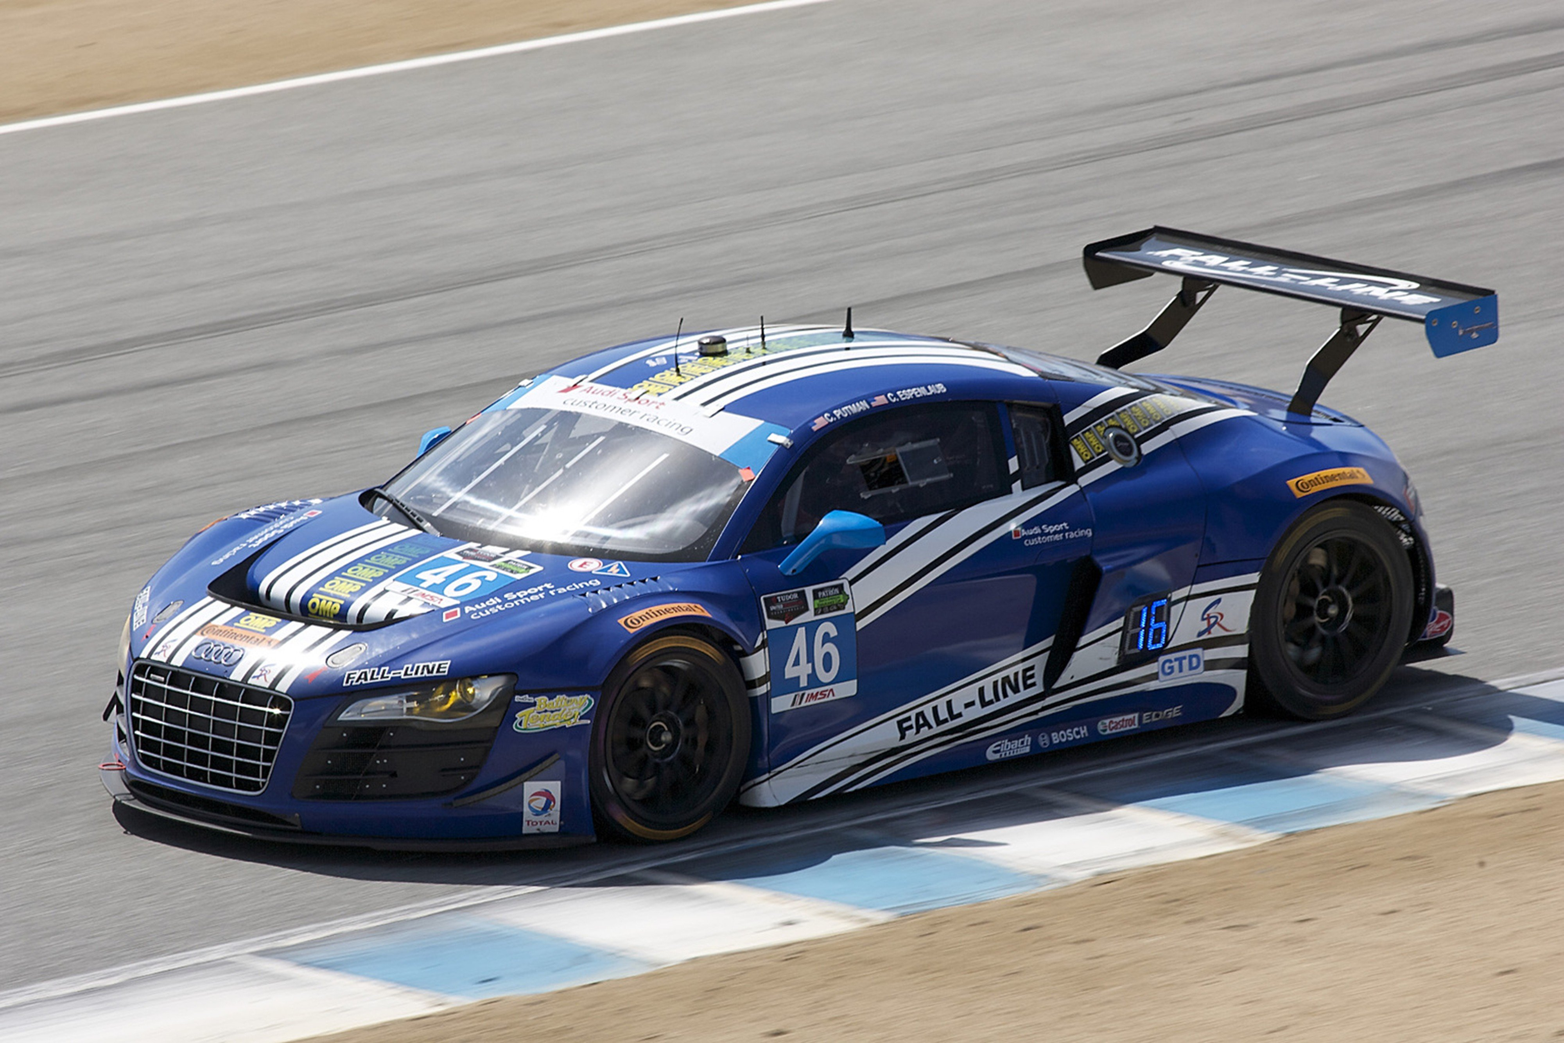
INTRODUCTION
Overtake Madness is a highly interactive and feature-rich gaming website designed to provide users with an engaging and smooth gaming experience. This website allows users to register securely, choose from multiple games, customize settings, and experience immersive gameplay. Built with modern technologies like HTML, CSS, JavaScript, React, and Java, this project ensures high performance and scalability.
SDG Goal:
This project aligns with SDG 9 - Industry, Innovation, and Infrastructure, as it promotes technological advancements in the gaming industry by implementing modern web-based gaming solutions.

Slide 4
OBJECTIVES OF THE PROJECT
Develop a dynamic gaming platform with interactive UI and seamless navigation.
Implement secure authentication using Firebase for user safety.
Offer a variety of games on a single platform for different user preferences.
Provide customization options, including brightness adjustments and profile updates.
Ensure smooth performance across all devices with optimized code.
Enhance the gaming experience using animations and responsive designs.

Slide 5
TECHNOLOGY STACK
Frontend Technologies:
✔ HTML, CSS, JavaScript – For structuring & designing pages.
✔ React.js – For dynamic UI and better user experience.
Backend Technologies:
✔ Java (Spring Boot) / Node.js – For handling backend logic.
✔ Firebase – For real-time authentication and database storage.
Database:
✔ Firebase / MySQL – To manage user accounts and game data.

Slide 6
LITERATURE REVIEW OF THE PROJECT
Evolution of Gaming Websites:
Gaming websites have evolved from basic Flash-based games to highly interactive JavaScript & React-powered platforms. Today, most gaming sites leverage WebGL, HTML5, and advanced JavaScript libraries to create seamless experiences.
Security in Online Gaming:
With the rise in cyber threats and data breaches, security in gaming websites is crucial. Our project uses Firebase Authentication to ensure encrypted and secure login systems.
User Engagement Strategies:
Studies show that UI/UX design directly affects user retention. A well-designed homepage with visually appealing elements improves the gaming experience. Overtake Madness integrates animations, smooth transitions, and high-quality graphics for enhanced engagement.
Technological Trends:
Modern gaming websites rely on frameworks like React.js and Java for smooth interactions. Our project implements React.js for the frontend, Java for backend processing, and Firebase/MySQL for data storage to ensure efficiency.

Slide 7


HARDWARE AND SOFTWARE REQUIREMENT
🔹 Hardware Requirements
✔ Minimum 4GB RAM, 1.5 GHz processor for smooth performance.
✔ A dedicated graphics card for enhanced gaming visuals.
🔹 Software Requirements
✔ Code Editor (VS Code) – For development.
✔ Modern Web Browsers (Chrome, Firefox, Edge) – For testing.
✔ GitHub / Git – For version control and collaboration.

Slide 8
PROJECT MODULES
🔹 Authentication Module
Secure login and registration with Firebase Authentication.
Encrypted password storage to prevent hacking attempts.
Email verification and forgot password option for user security.
🔹 Home Page Module
"Get Started" button that directs users to the game selection screen.
Showcases 4 game options with engaging UI.
Uses React.js animations for smooth transitions.
🔹 Game Play Module
Allows users to select and play games in a seamless manner.
Features interactive game mechanics and JavaScript-based game logic.
Ensures fast rendering speeds using modern frontend frameworks.
🔹 Settings Module
Users can change their username and update profile details.
Brightness adjustments for better visibility.
Option to reset settings to default values.

Slide 9
WORKING OF THE PROJECT
1️User Authentication
The system starts with a login/signup page.
Users must enter credentials to access the platform.
The authentication module verifies the details and grants access.
2 Dashboard & Navigation
Once logged in, users are redirected to the main dashboard.
The dashboard displays key options/modules related to the system.
3 Core Functionalities & User Interaction
Users can interact with different modules based on their needs.
Each module processes input, performs calculations, and provides output
.
4️Data Processing & System Operations
Inputs are validated, stored, and processed based on project requirements.
The backend manages database operations, API calls, and computations.

Slide 10
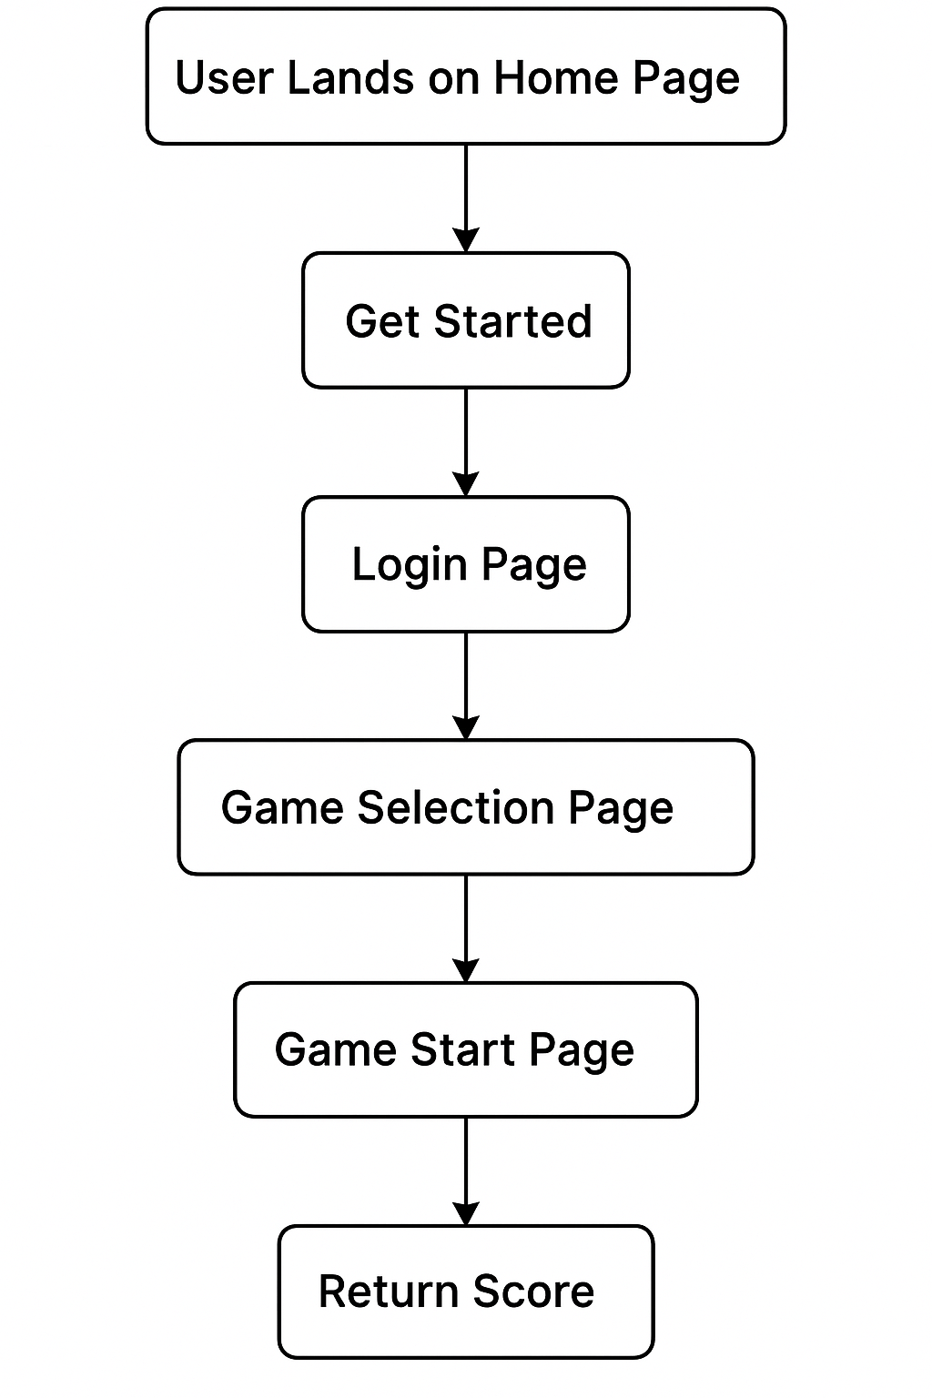
Working Cont...
5️ Flowchart Integration
A visual representation of the project flow can be shown using a flowchart.
The flowchart will depict major steps, decision-making points,
and interactions between different modules.
6️ Final Output & Reporting
The system processes the user’s requests and provides results.
Users can view summaries, reports, or perform further actions.
7️ Logout & Session Management
Users can log out securely.
The system ensures proper session handling for security.
FLOWCHART

Slide 11
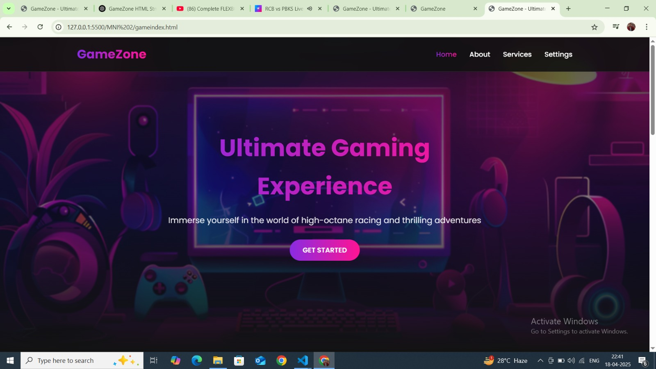
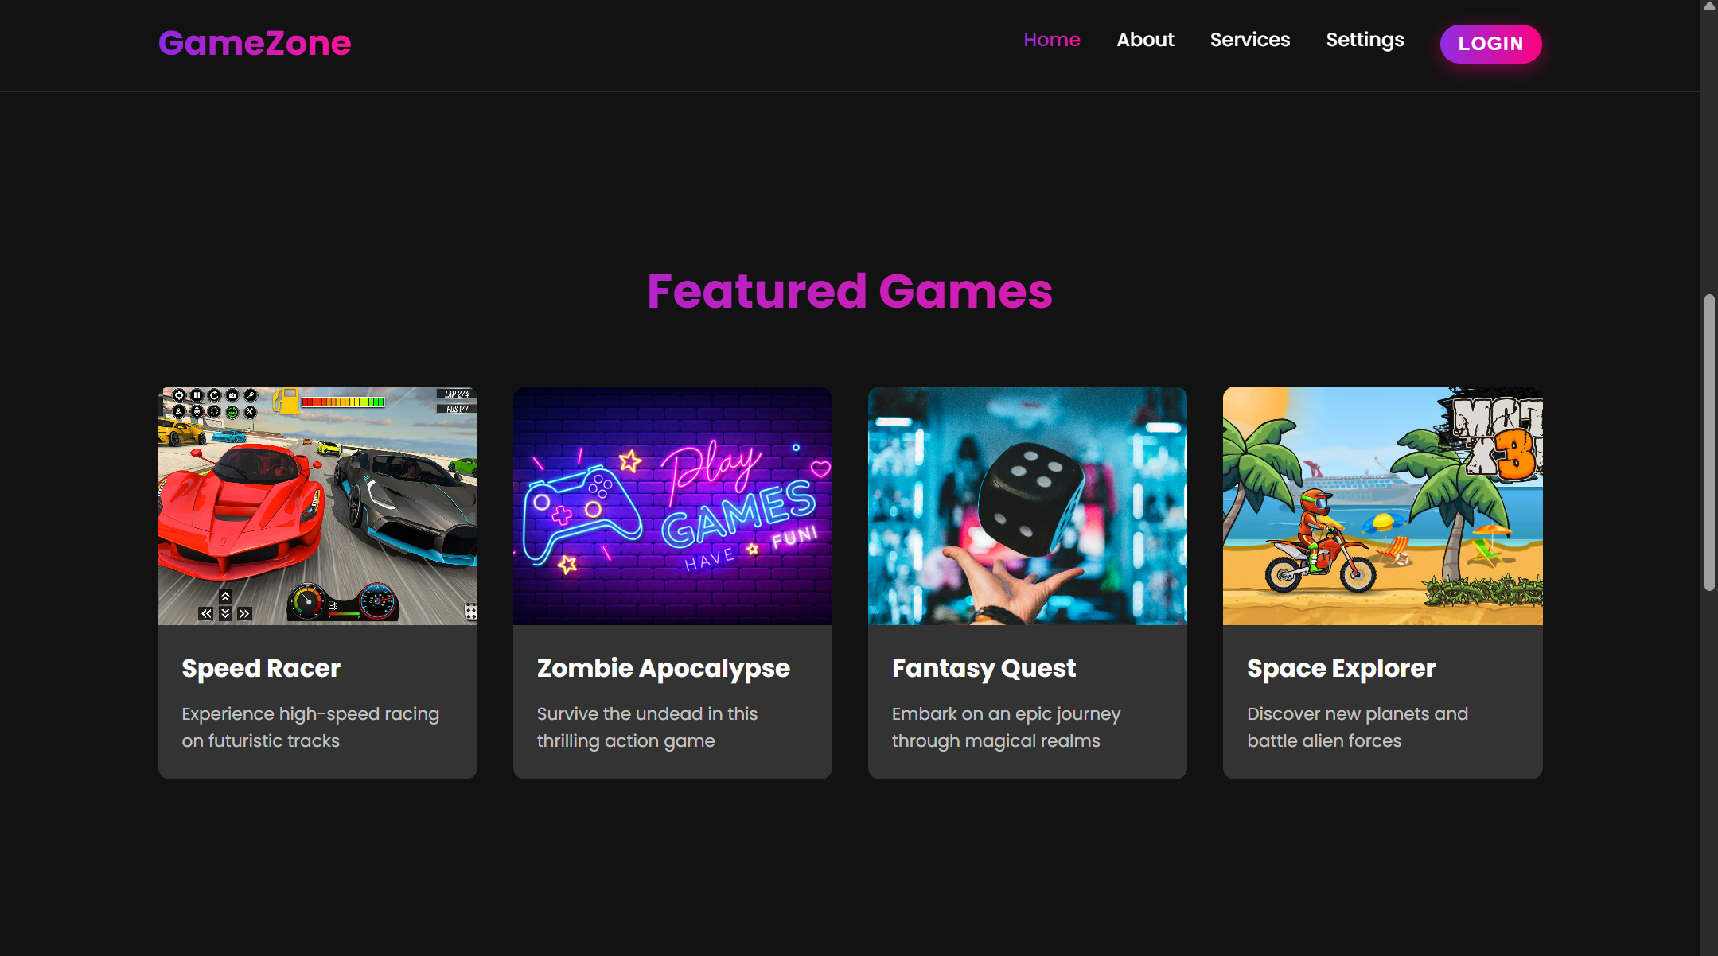
OVERVIEW OF THE
PROJECT

Slide 12
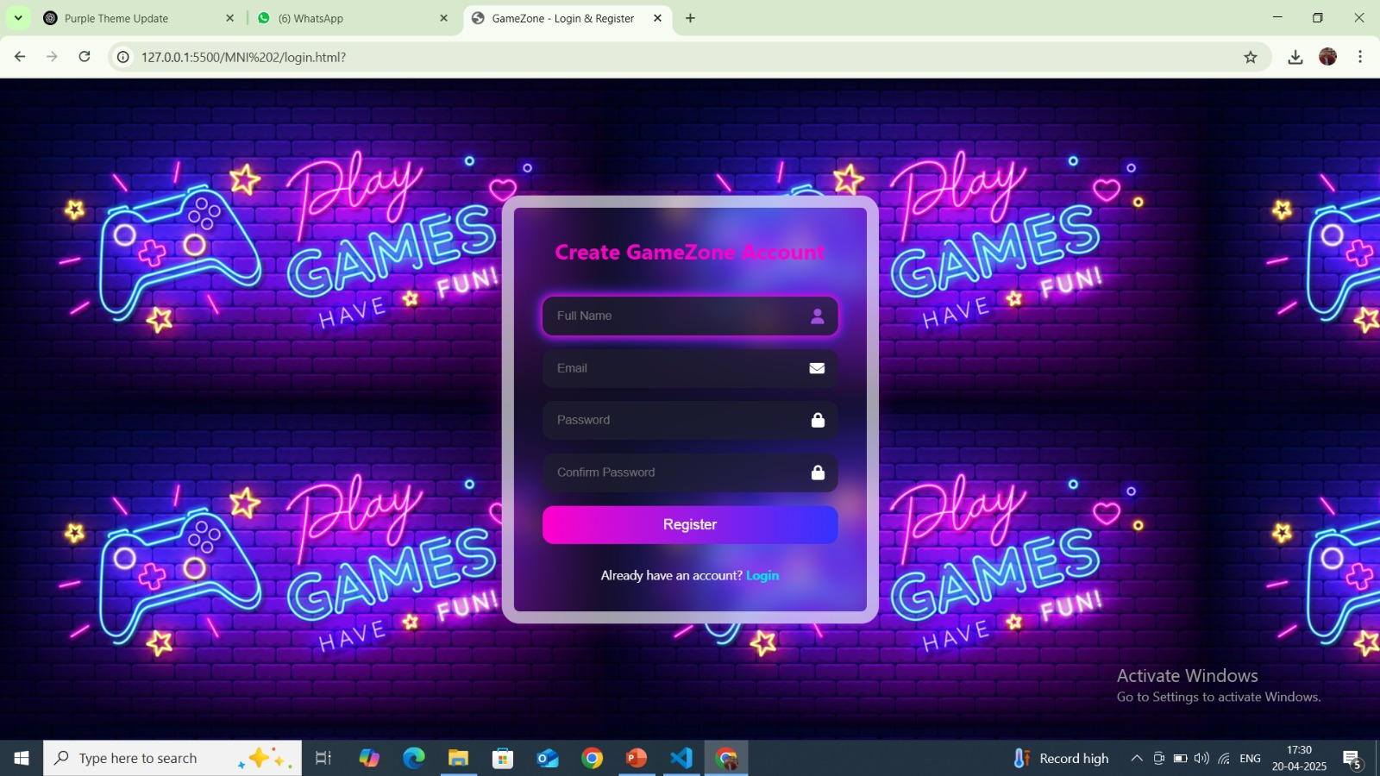
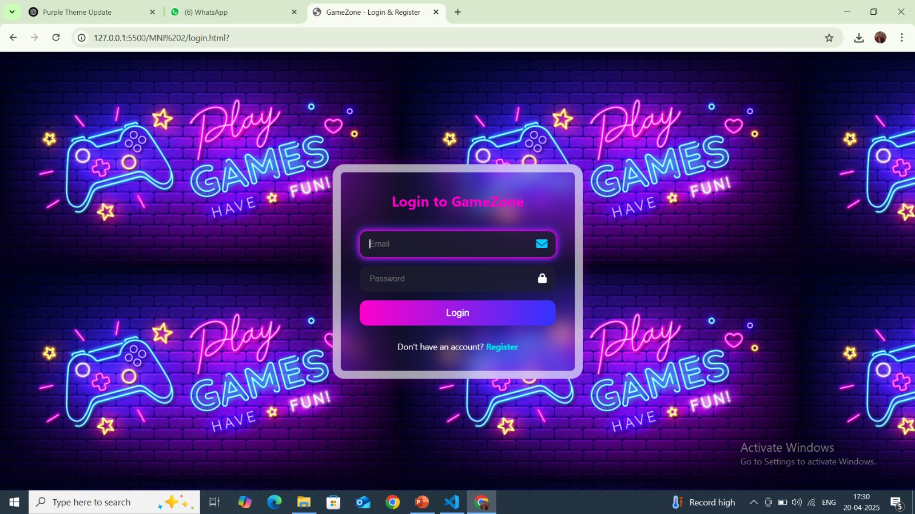

Slide 13
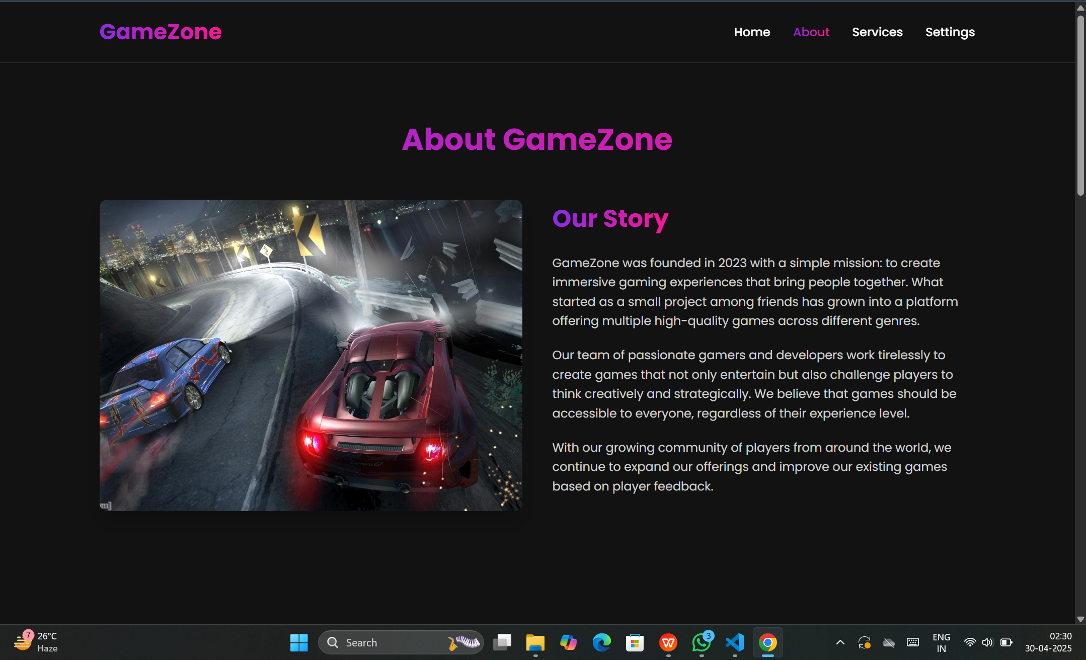
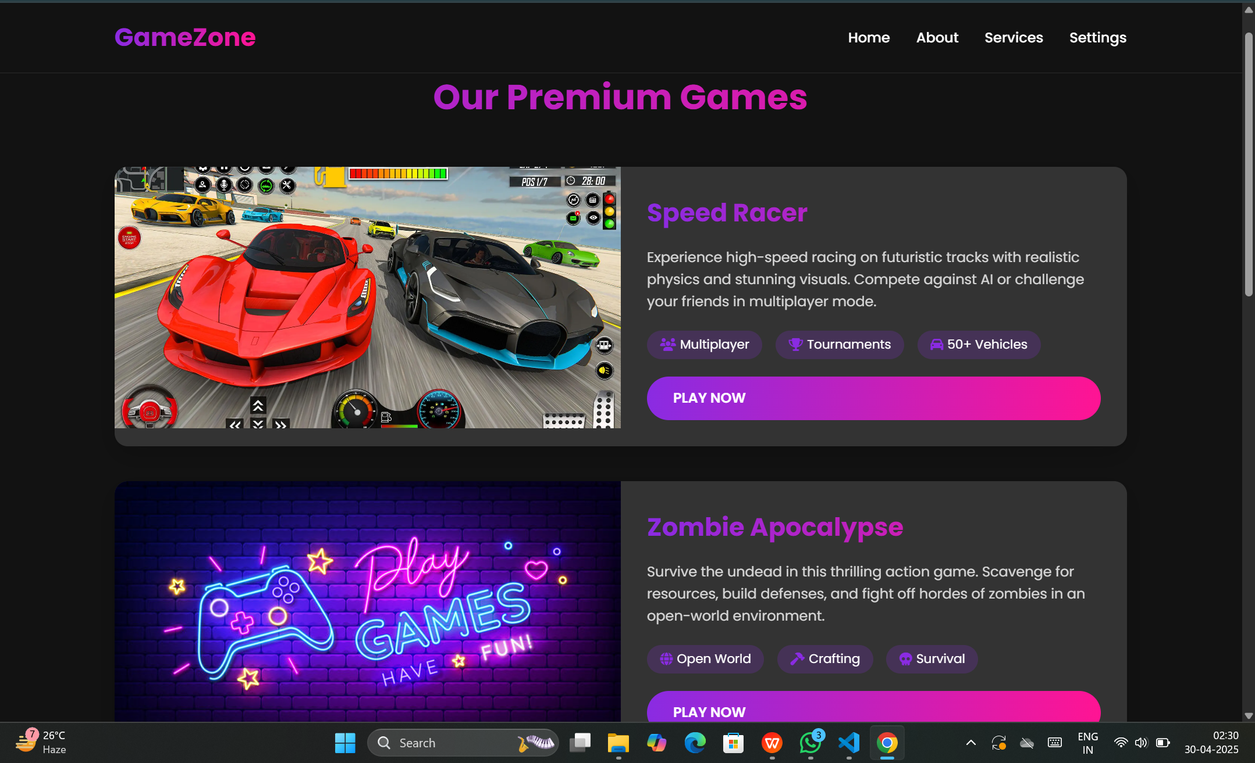

Slide 14
FEATURES AND INNOVATIONS
✔ Smooth Animations using modern JavaScript libraries.
✔ Secure Authentication with Firebase login system.
✔ Multiple Gaming Options on one platform.
✔ Customization Features like brightness and username change.
✔ Optimized Performance for smooth gaming experience.

Slide 15

THANKS

